Slide 1
What makes a SUCCESSFUL Movie?
FCS2 Team 2:
Lee Lin Yang Glenn (U2321581J) ​
Lee Yi Yuan (U2322108K)​
Wong Jing Han (U2323370K)​
Notes:
Hello Everyone, Today I Will Be Presenting on my Group’s Project where we attempt to find out what contributes to a successful movies and if we can predict the success of a movie.

Slide 2
Table of Contents
Exploratory
Data Analysis
Outcome
01
02
03
04
Motivation
Machine Learning
Notes:
I will be going through
Our Motivations
EDA
Machine Learning Attempts
Findings

Slide 3
01
Motivation
Notes:
Moving on to our Motivation,

Slide 4


Motivation – Brief History
Release Date: 14 October 2007
Budget: 15,000 USD
Box office: 194.2 Million USD
Release Date: 1 April 2022
Budget: 75 million USD
Box office: 167.5 Million USD
Notes:
In the current century, a lot of films that achieved unexpected success comes to mind.
Paranormal Activity, a movie shot with the budget of 15,000 USD managed to end their run with earnings of $194 Million USD in Total.
Another movie, Morbius, which was ridiculed worldwide and considered a failure by many still manage to end their run in the green zone.
This makes the topic worth exploring as there are many films that despite only gaining relevance when entering the box office, those films still managed to gain notable financial success.

Slide 5
Motivation – Success Atribution
Possible “Success” Attributions:
Genre?
Actors?
Budget?
Votes?
Notes:
For this project, We aim to find out if it is possible to predict success of movies based on their characteristics. Where we quantify “Success” from a financial point of view and make use of variables to help in our Exploratory Data Analysis or EDA for short and also to help predict whether a movie is Successful.

Slide 6
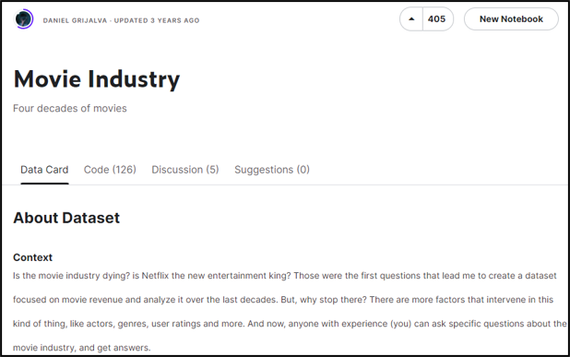
Motivation – Data Set
Movie Industry
By Daniel Grijalva
Variables for Success
Extra Variables
Good for In-Depth Analysis
Good for Machine Learning
Notes:
The Dataset we are using is from Kaggle. It is about “Movie Industry” by “Daniel Grijalva”.
The dataset contains around 7000 movies from the 1980s to 2020.
The Variables in this dataset contain the key variables needed to predict success.
This dataset also contains “director”, “writer” and “star actor”, all are important figures for movies which are not available in this specific format in other available datasets.
Altogether, this data set is good for a more in-depth analysis and aid in machine learning.

Slide 7
Is It Possible to Predict The Success of Movies Based on Their Characteristics?
Project Problem Statement
Notes:
Thus, the problem statement for our project is
“Is It Possible to Predict The Success of Movies Based on Their Characteristics?”.

Slide 8
02
Exploratory Data Analysis
Notes:
Moving on to our EDA on the data set,

Slide 9
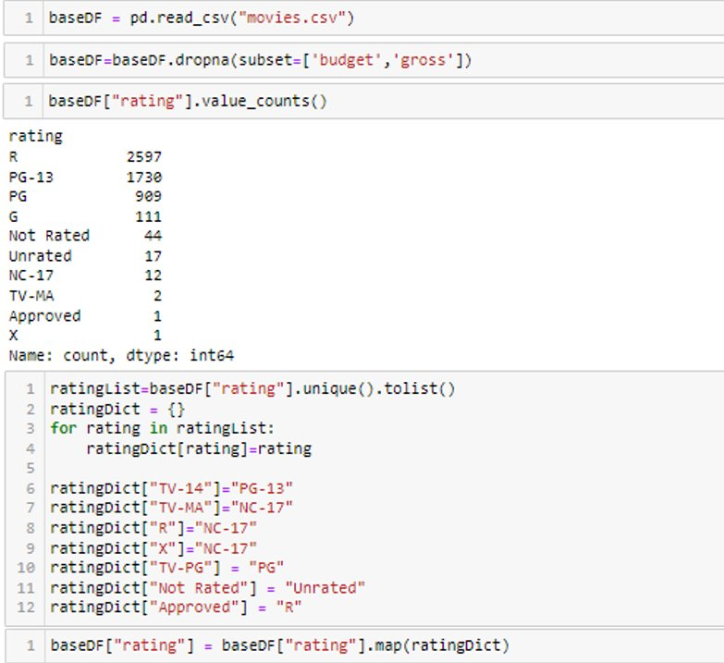

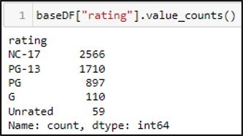
EDA – Data Preparations
Data Cleaning
Defining and Quantifying “Success”
Notes:
We first dropped the empty rows for budget and gross as these variables are what determines financial success.
The Success is then defined by checking whether a movie’s gross profit is at least 1.5x the budget. If yes, then the movie is successful.
In Addition. the ratings which are similar to one another are recategorized for an easier and better analysis of the ratings variable.

Slide 10
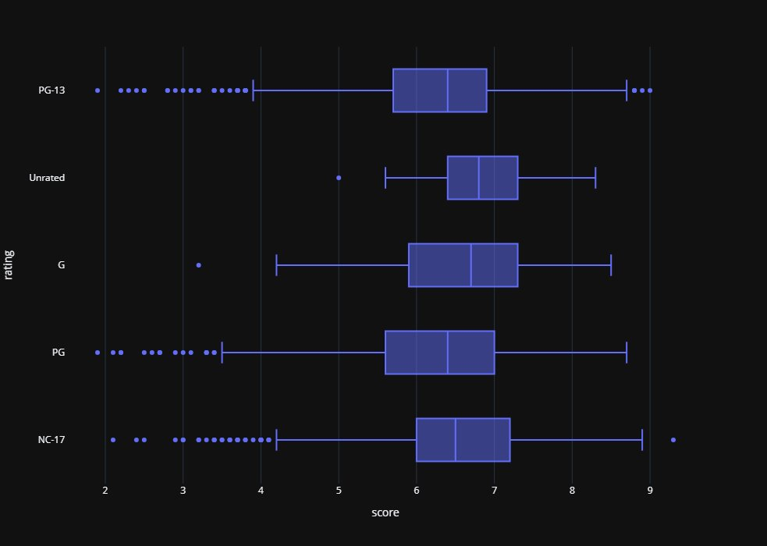
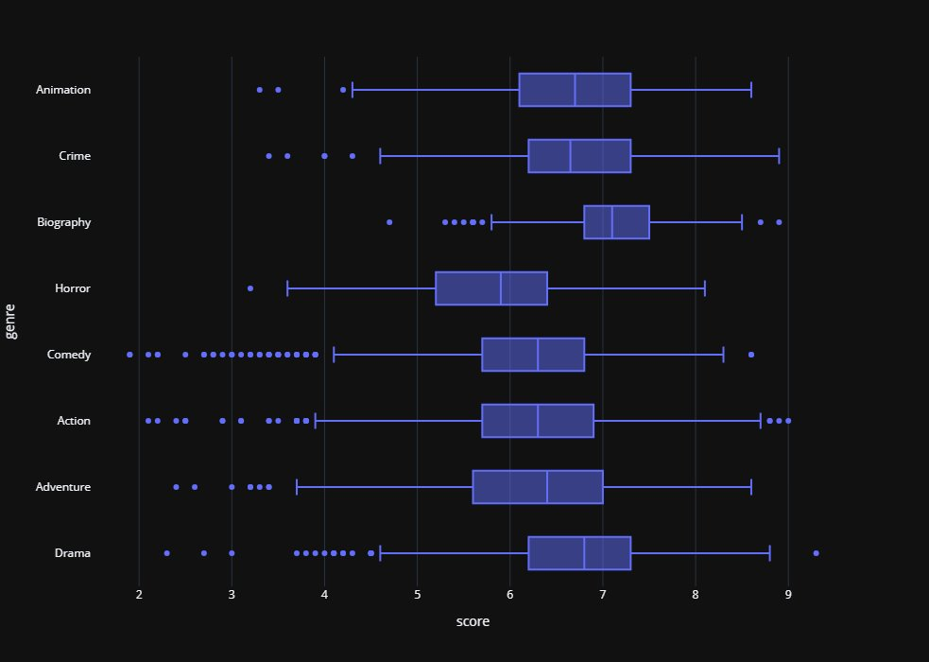
EDA – Insights of Initial Anaylsis
Box Plot of Ratings
Box Plot of Genre
Notes:
From our analysis, the key findings that we found are as such,
The ratings of movies can play a part to movie’s score, but we determined it to likely be insignificant.
Certain Genres allows a movie to score better comparatively.

Slide 11
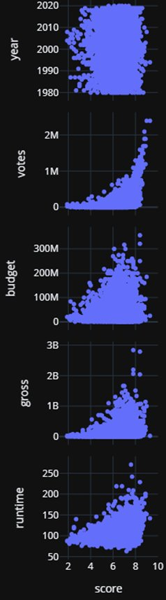
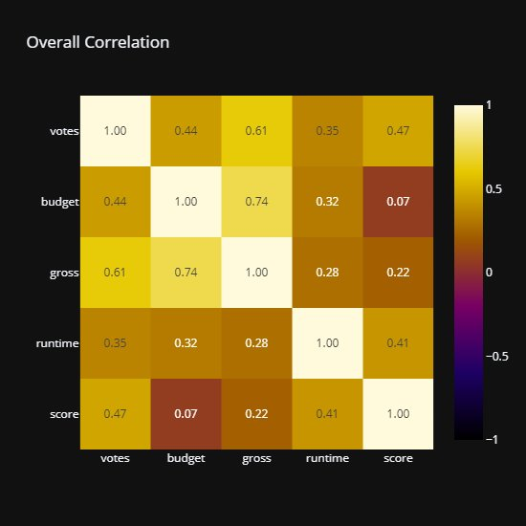
EDA – Insights of Initial Anaylsis
Scatterplot in relation to Score
Correlation Matrix of Variables
Notes:
Also, trends can be observed across all variables categorically on score except for year.
However, this trend may not indicate how much correlation is there to other variables as score may be dependent on other variables.
From the correlation matrix, we found votes and budgets to be strongly correlated to gross, one of the determining variables for success.

Slide 12
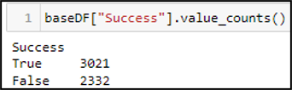
EDA – Insights of Initial Anaylsis
56.4%
Successful
Notes:
From our definition of Success, we found that 56.4% of movies in the dataset are considered Successful.

Slide 13
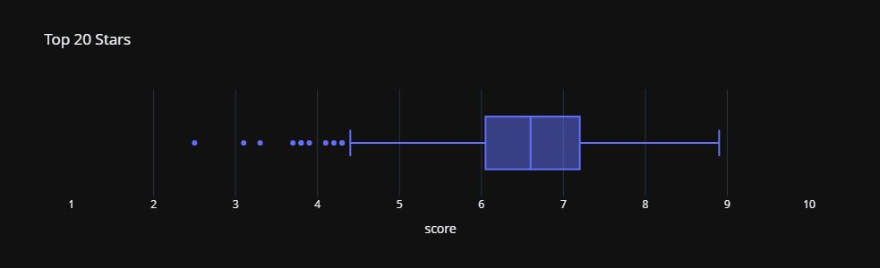
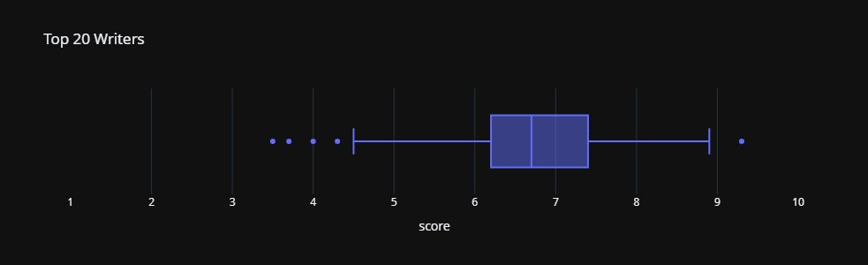
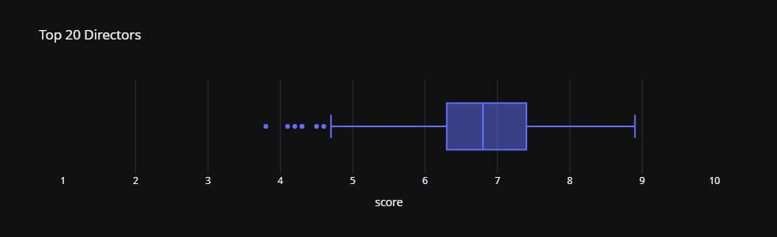
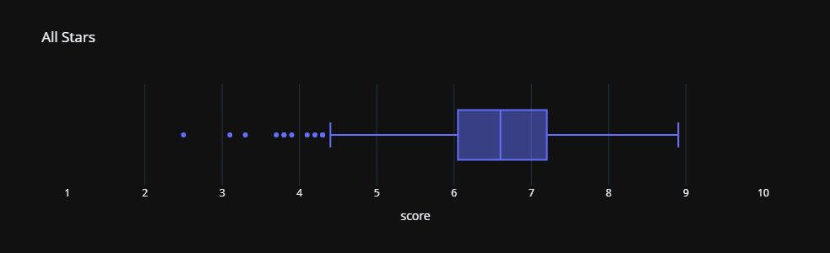
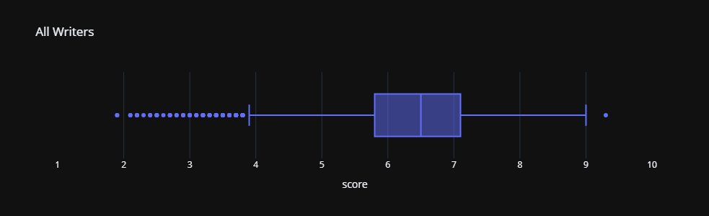
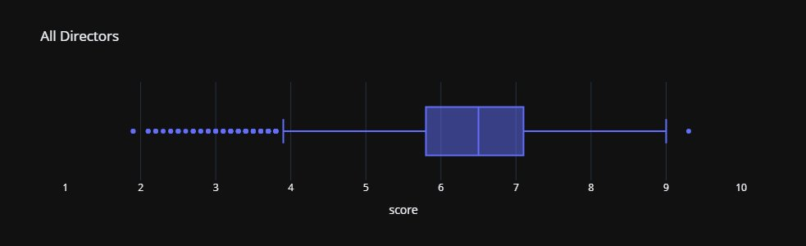

EDA – Insights of Further Analysis
Top 20 Stars: 63.4% Successful
Top 20 Writers: 62.75% Successful
Top 20 Directors: 58.8% Successful
Versus
Top 1000 Successful Movies
Notes:
After our initial analysis, we moved to analyze the top 20 writers, directors and stars.
We learnt that the precedence to movie success is in the order of star, writer and director.
When compared against the top 1000 successful movies by gross, the order changes to star, director and writer.
These findings were surprising because the content of movies came from the writers and yet the stars had the most impact in 2 separate comparisons.

Slide 14
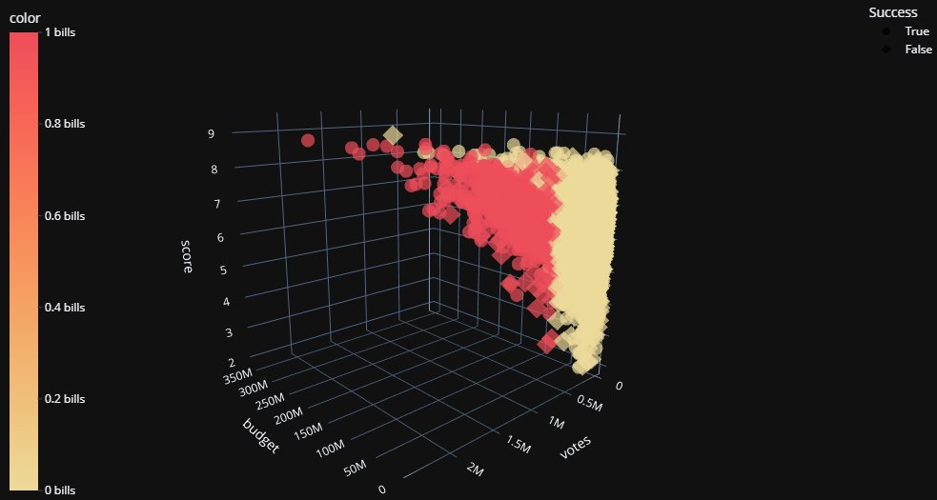
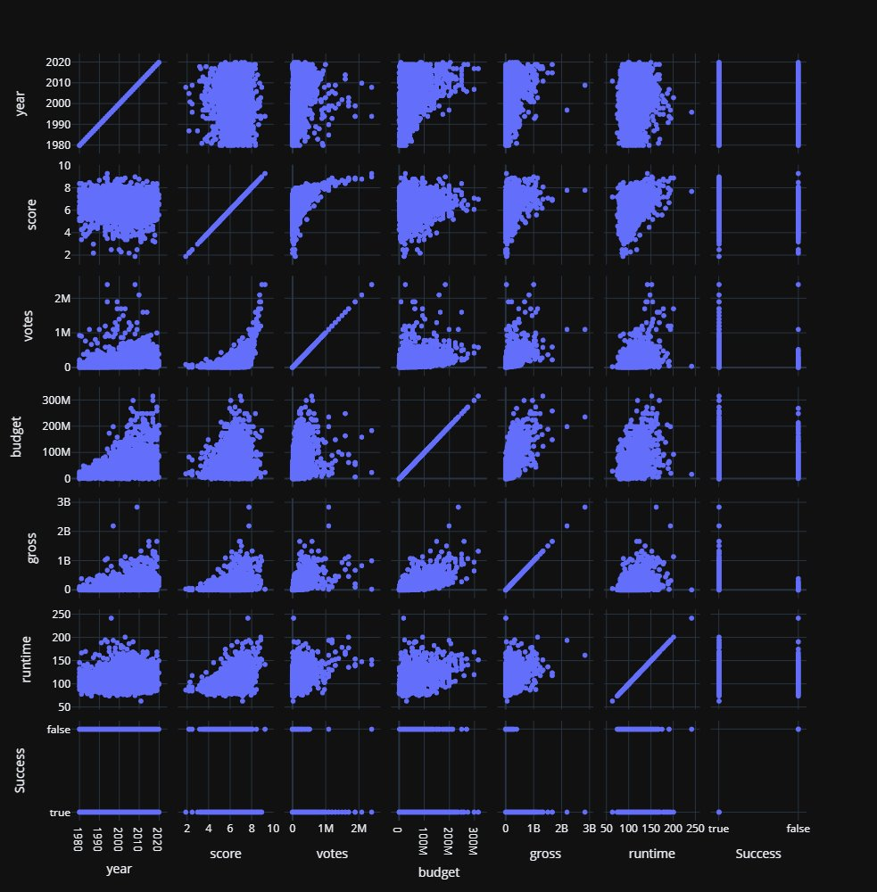
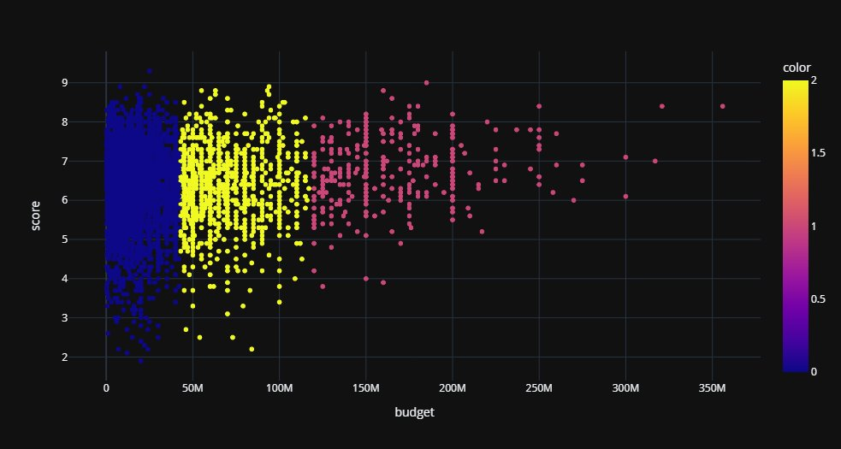
EDA – Visualisation (Plotly)
Notes:
For our data visualization, we used the Plotly library,
Plotly is useful in creating interactive models which can zoom into key points.
Due to its panning abilities, it is an ideal tool for 3D models, where we used for Kmeans.
Furthermore, it provides many customizable features, and it is easy on the eye.
Making it ideal to use for data visualization.

Slide 15
03
Machine Learning
Notes:
Moving on to our Machine Learning portion,

Slide 16
ML - Techniques
XGBoost
Neural Networks
KMeans
Notes:
We did not have a main Machine Learning technique in mind when we began the project,
As such we tried different machine learning techniques and will showcase in the subsequent slides.
The three machine learning techniques that we have tried are XGBoost, Neural Network and K-Means.

Slide 17
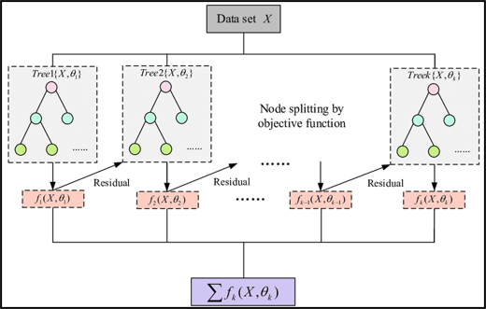
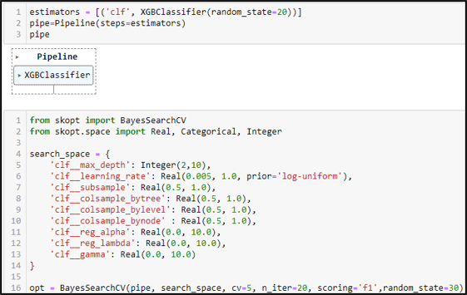
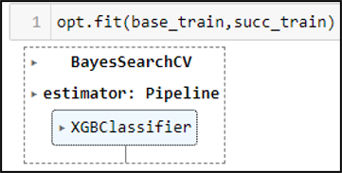
ML - XGBoost
XGBoost Model Reference
Notes:
XGBoost is a type of gradient-boosted decision tree and is suitable for to predict whether a movie is successful based on certain variables.
The process for implementation requires a pipeline to be setup for XGBoost which works together with BayesSearchCV to optimize and find the best model based on the pre-defined range of search space and the data received.
Once the model has been fitted, the model can be used to predict the Success of movies.
Judging the F1 Score and Accuracy observed, the model obtained from XGBoost can be considered good.

Slide 18
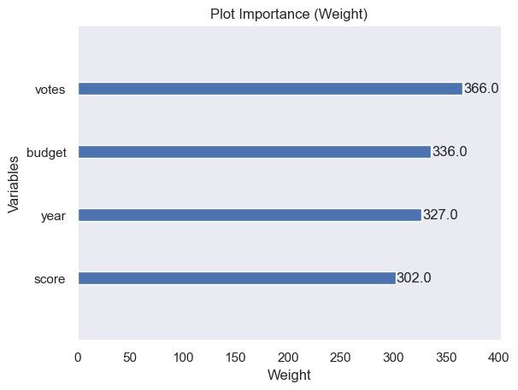
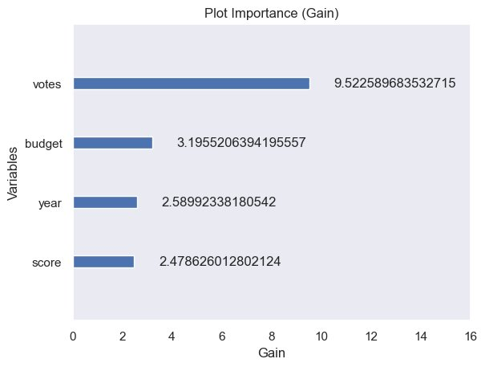
ML - XGBoost
Notes:
From the plot importance of the model, the most impactful variable turned out to be votes and that is surprising as one would expect budget to impact Success more given how success is quantified.

Slide 19
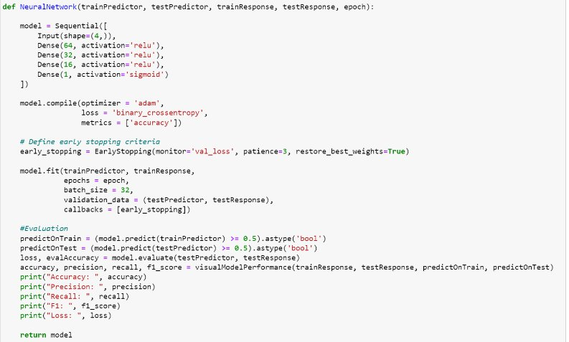
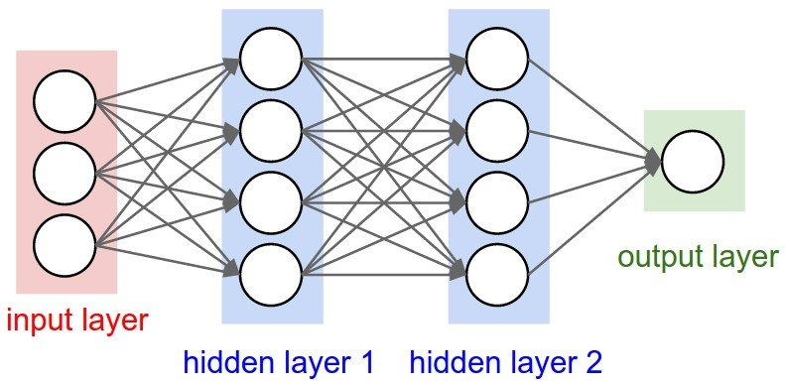
ML – Neural Network
Simplified Neural Network Model
Notes:
Our group also tried using Neural Network to predict whether a movie is successful based on certain variables.
The Neural Network uses 3 Dense Layer and 1 Output Layer to predict a movie success.
The 3 Dense Layer uses “ReLU” activation function and the Output uses a Sigmoid Function.
The Model is Optimized with Adam and uses the Binary Crossentropy Loss Function.
Once the model has been fitted, the model can be used to predict whether a movie is successful.

Slide 20
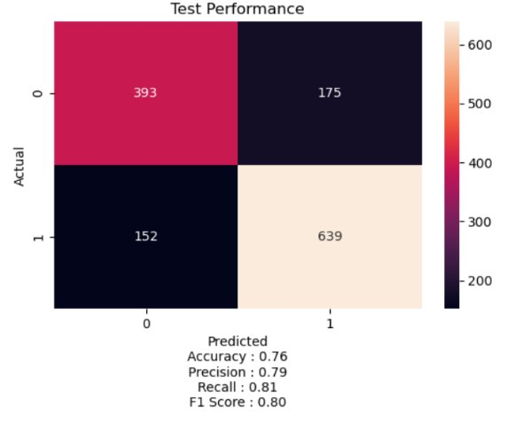
ML – Neural Network
Notes:
From various testing, we found that the model which uses normalized input yields the best results.
From the accuracy, precision, recall and F1 Score of the model. We can conclude that the model obtained from Neural Network using normalized inputs can be considered good.

Slide 21
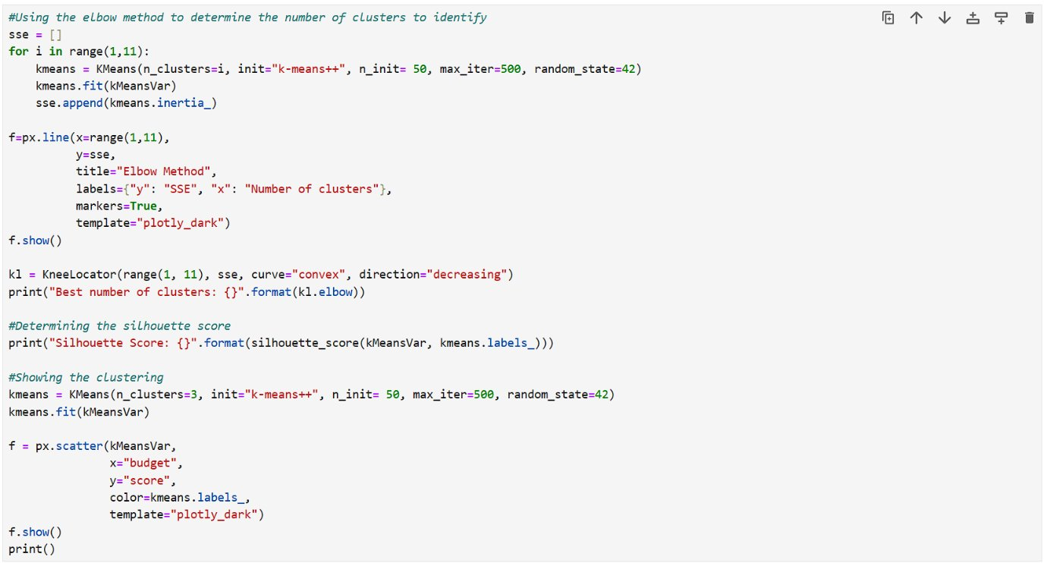
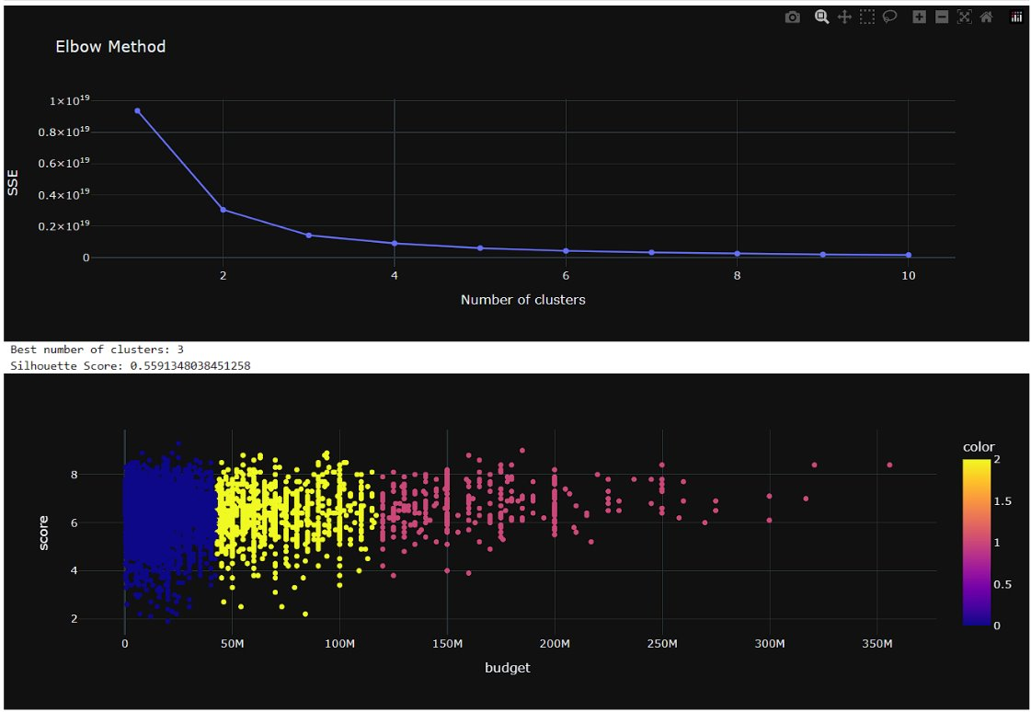
ML – K Means Clustering
Elbow Method
Silhouette Score
Notes:
Lastly, our group also tried KMeans to predict whether a movie will be successful or not.
By applying the elbow method, we determined that the ideal number of clusters is 3.
Looking at the silhouette score, we got a rather high value of 0.55. Implying that the data is relatively well-separated.

Slide 22
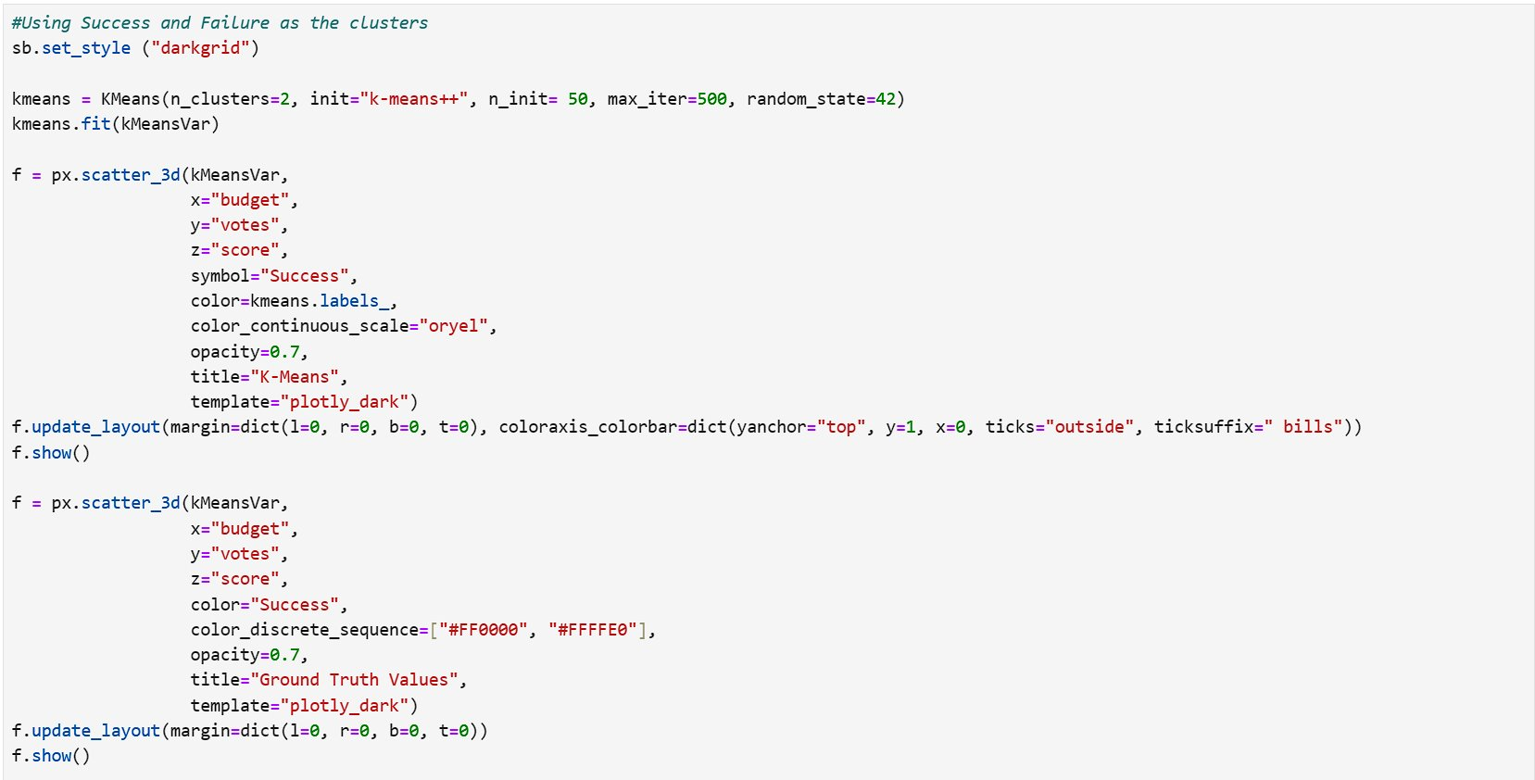
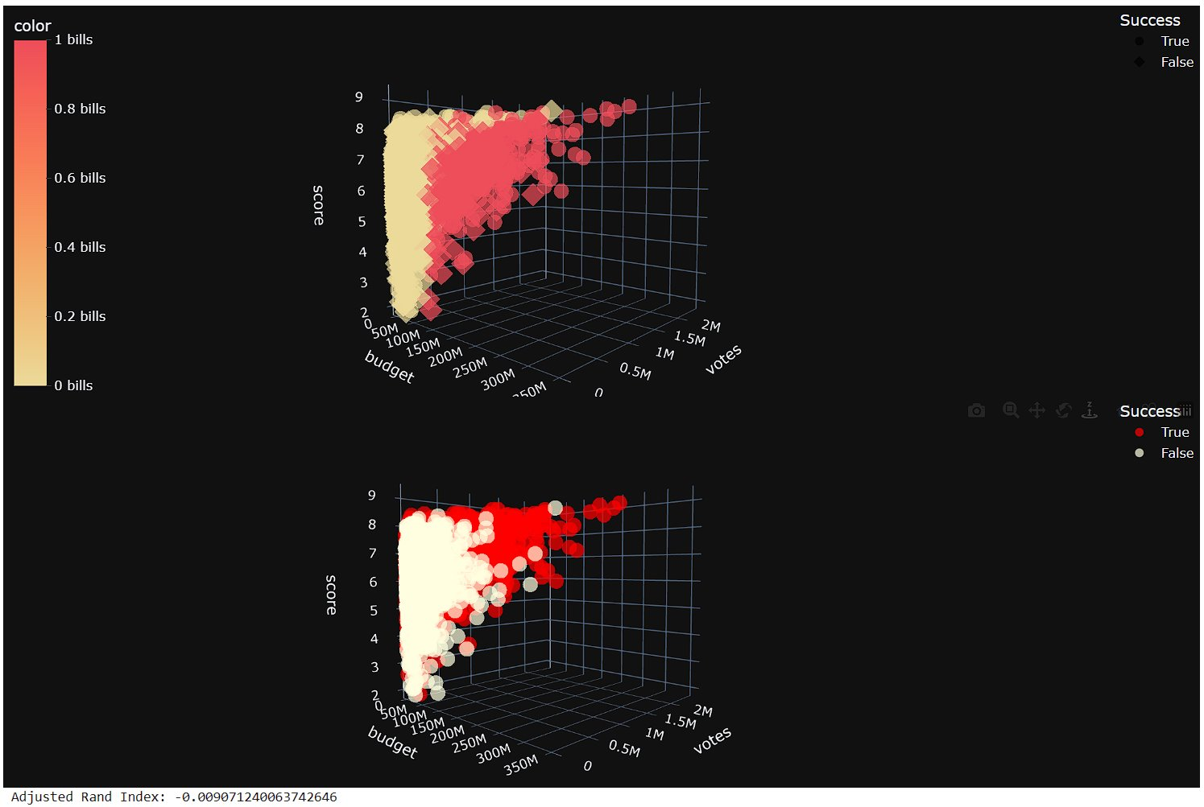
ML – K Means Clustering
Using KMeans
Ground Truth Values
ARI
Notes:
However, since we have ground truth values of Successful and Not Successful, we attempted to use Kmeans to see if we can use it to predict if a data resides in a success cluster or not.
The circle markers indicate the data being in a success clusters.
As seen from the two 3D Models, and the Adjusted Rand Index being close to 0, the probability of data being in the correct cluster is low. Implying that there is a high possibility of random clustering.
Hence, our Kmeans model is not a good model to predict the success of a movie.

Slide 23
04
Outcome
Notes:
Moving on to our Outcome of the Project,

Slide 24
Outcome – Outcome of Project
Relationship Between Variables
“Star” has the most impact
Two Functional ML Models
Answered Our Problem Statement
Found Factors Contributing to Success
Functional Models to Predict Success
Notes:
Through our EDA, we learnt how certain variables are related to each other and found out that the main star has the most impact on the success of films among other figures.
Through our ML implementations, we managed to create two models that work well in predicting the success of movies based on the input variables.
Altogether, our findings did answer our defined questions as we learnt of factors which contributes to the success of films and created models that can predict success of movie.

Slide 25
Outcome – Interesting Findings
The most impactful variable among inputs
Votes
Expected: Budget -> Votes -> Year -> Score
Actual: Votes -> Budget -> Year -> Score
Variables relating to Human Interactions may be better?
Notes:
An interesting finding is found from the plot importance graph of the XGBoost model, with votes being the most impactful variable among the 4 variables used.
This is peculiar due to our EDA and how success was defined in this project, where budget would be expected to be the leading variable to determine success.
Hence, it is possible to hypothesize that other variables which relates to human interactions are required to better predict the success of movies and this is one of the better models that can be obtained from the dataset that we have chosen.

Slide 26
Outcome – Conclusion
Popular/Experienced Key Figures Contribute to Success
ML Models can be further improved
More Key Variables
Better Tackle Similar Natured Questions
Variables like “Popularity”, “Cast”, “Directors”
May Produce Better Answers and Predictions
Notes:
To conclude,
The key figures of the movie will likely dictate the success of a movie.
While the model created with the use of 4 variables in the dataset selected was good, the model could have potentially been better with other variables that measured human interactions in relation to the film.
As such, to better tackle a question of similar nature. Variables like “popularity” pertaining to the film or the cast in the films would produce better answers and predictions.

Slide 27
Thank You
Please keep this slide for attribution
Notes:
Thank you.

